Slide 1

Hardware Components Interfacing to PLC
Analogue IO – Part 2
Contents are mainly from SIMATIC S7-1500 CPU 1512C-1 PN Manual

Slide 2
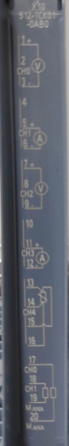
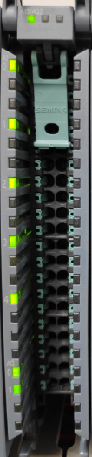
Analog Input
Most PLC analog inputs are able to accept voltage and current
Configurable by dip switches or software configurable (depending on PLC type)
Siemens S7-1500 PLC and the remote I/O ET200 SP input types are software configurable
Voltage analog signals
Care to be taken for wire length (voltage drop result in accurate measurement
Current analog signals
Do not suffer from long cables as current is constant, voltage drop from cables taken care by the power supply
Cable segregation from power cables and grounding shall be practised

Slide 3
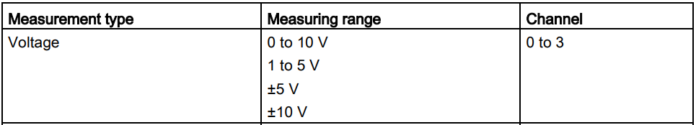
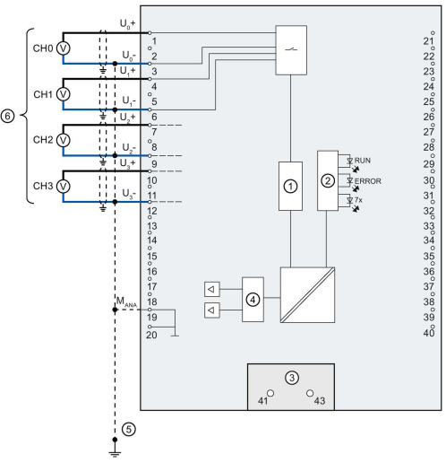
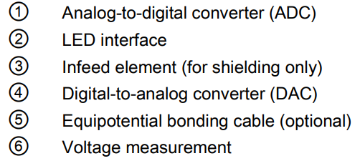
S7-1500 Analog Input Wiring: Voltage Inputs

Slide 4
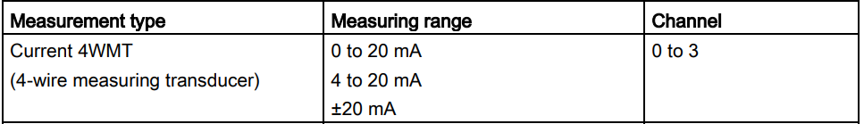
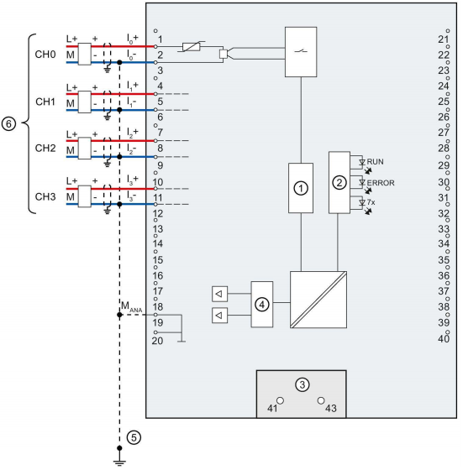
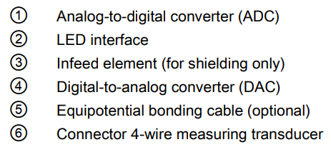
S7-1500 Analog Input Wiring: Current measurement (4-wire transducer)
Notes:
Next slide we would discuss about 2-wire and 4-wire transducer to better understand

Slide 5
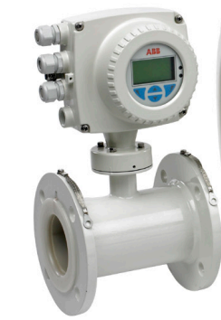
4-Wire Transducer Instrument
Instruments that require more power need to be powered independently, referred to as 4-wire transducer.
Flowmeter is a typical instrument that require more power to the circuitry to function. 4mA, 12Vdc is insufficient
2-wire for power to supply to transmitter
2-wire for signal to connect to PLC or other controllers
Typically output of 4-20mA
Power Supply
+ -
Power +
-
Signal +
-
PLC
IN+
IN-

Slide 6
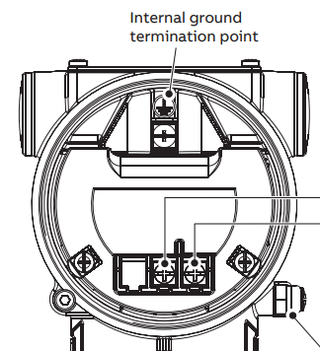
2-Wire Transducer Instrument
Alternative to 4-wire transducer, 2-wire transducers could be connected to channels 0 – 3.
(Select current, 4-wire transducer, 4-20mA)
Most low powered transmitters are 4-20mA, loop-powered type
Such as: Pressure, Temperature, Ultrasonic level Transmitter
Loop-powered transmitter is referred to as 2-Wire transmitter
The power is supplied by external source which carries the signal current to controller as a close loop
Power Supply
+ -
PLC
IN+
IN-
+ -
Notes:
Low powered as the minimum current is 4mA, and the voltage should not exceed 24Vdc. These instruments could usually function as low as 9Vdc.

Slide 7
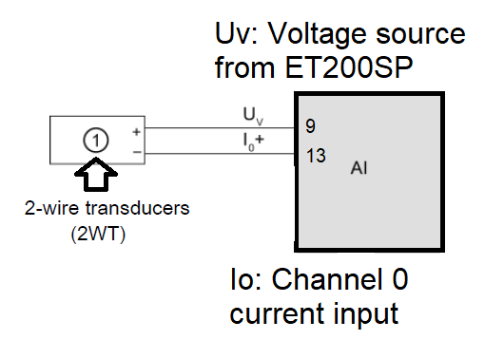
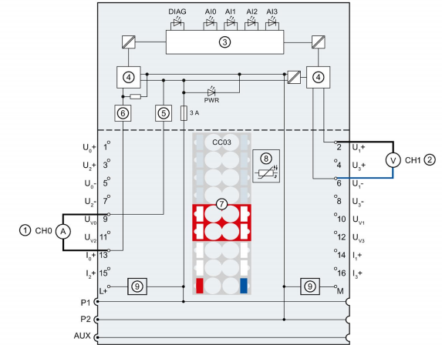
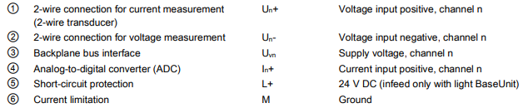
ET200SP Analog Input Wiring: Current measurement (2-wire transducer)

Slide 8
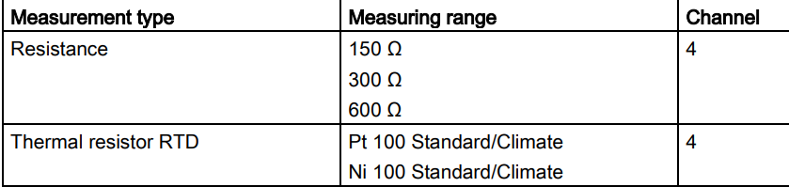
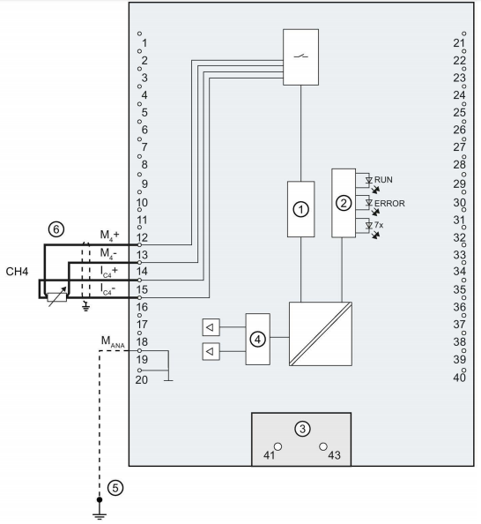
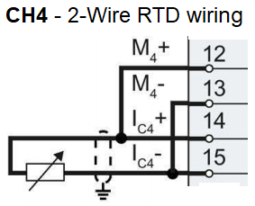
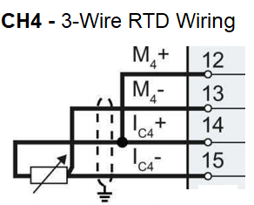
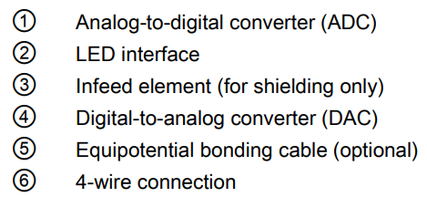
S7-1500 Analog Input Wiring: RTD (2, 3 & 4-wire connection)
Note: 2 & 3 wire connections:
Line resistance not compensated
Notes:
May not want to introduce this yet

Slide 9
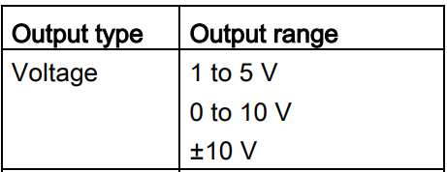
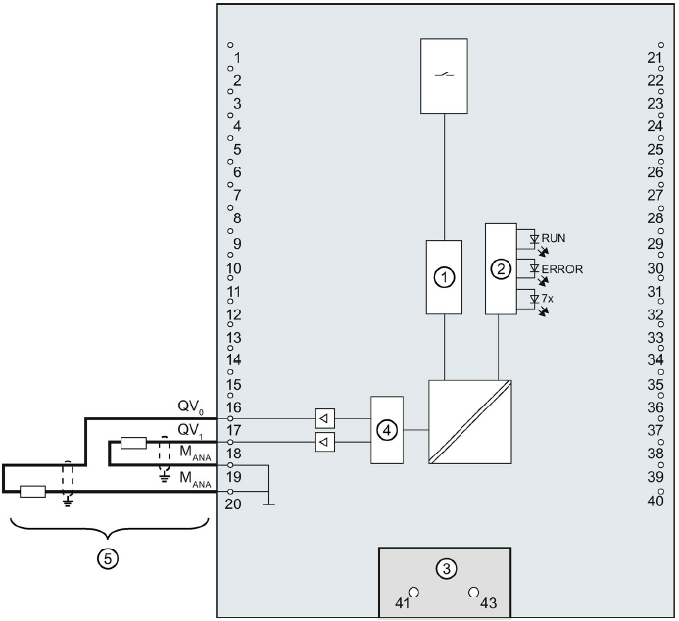
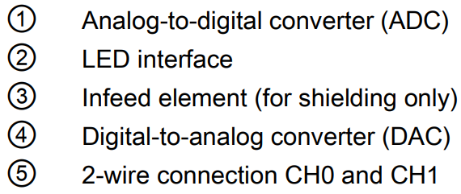
S7-1500 Analog Output Wiring: Voltage Output

Slide 10
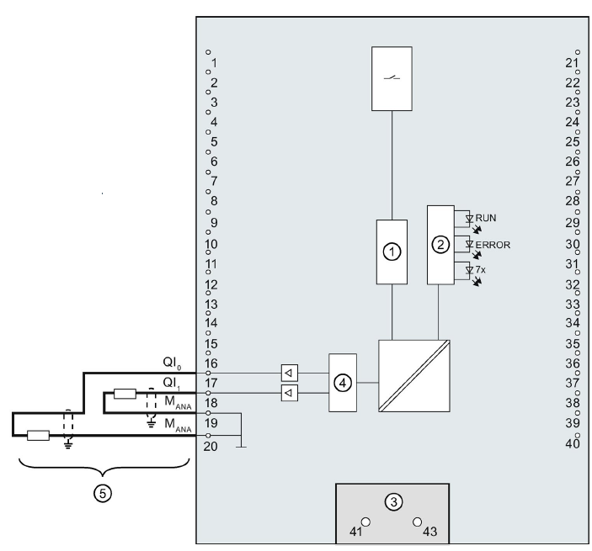
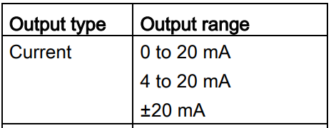
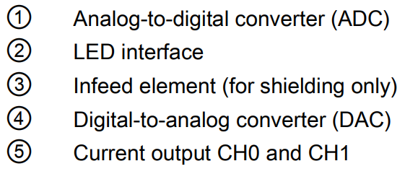
S7-1500 Analog Output Wiring: Current Output

Slide 11
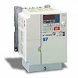
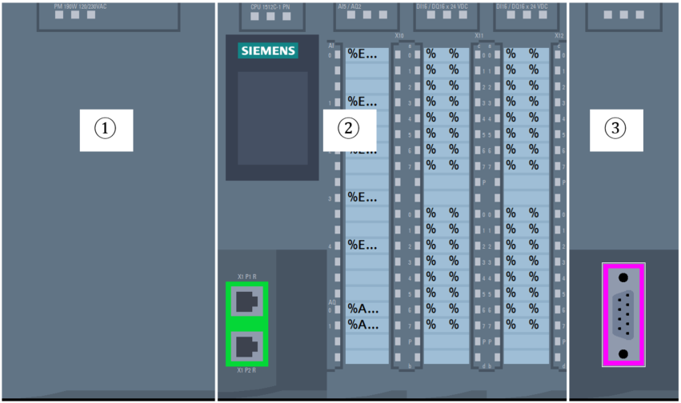
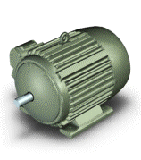
Control Application with Analog Output
PLC
VSD
AC Motor runs at speed According to 0 to 10 VDC signal
AC Induction motor could vary the speed according to the frequency.
Variable Speed Drives (VSD) is often used to throttle the speed of the motor to control pump flowrate / fan speed / speed of convenor belt etc
3 phase supply connection to motor
0 – 10 VDC
Signal to VSD

Slide 12
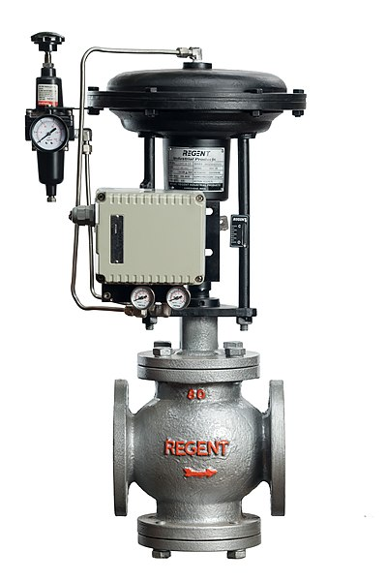
Control Application with Analog Output
PLC
Flowmeter Measure flowrate (l/s)
Control Valve
feedback
4-20mA Signal to PLC
Control valves are widely used in the industry. It could be used to control the amount of flowrate and often requires a flow measurement sensor feedback.
4-20mA
Signal to Control Valve
Opens / close to control flowrate according to 4-20mA signal received
https://commons.wikimedia.org/wiki/File:REGENT_CONTROL_VALVE_INDIA.jpg

Slide 13
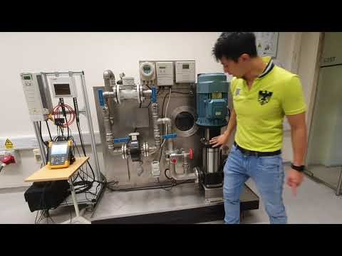
Case Study
This is a manual system.
How could we automate this system to achieve flow control?

Slide 14
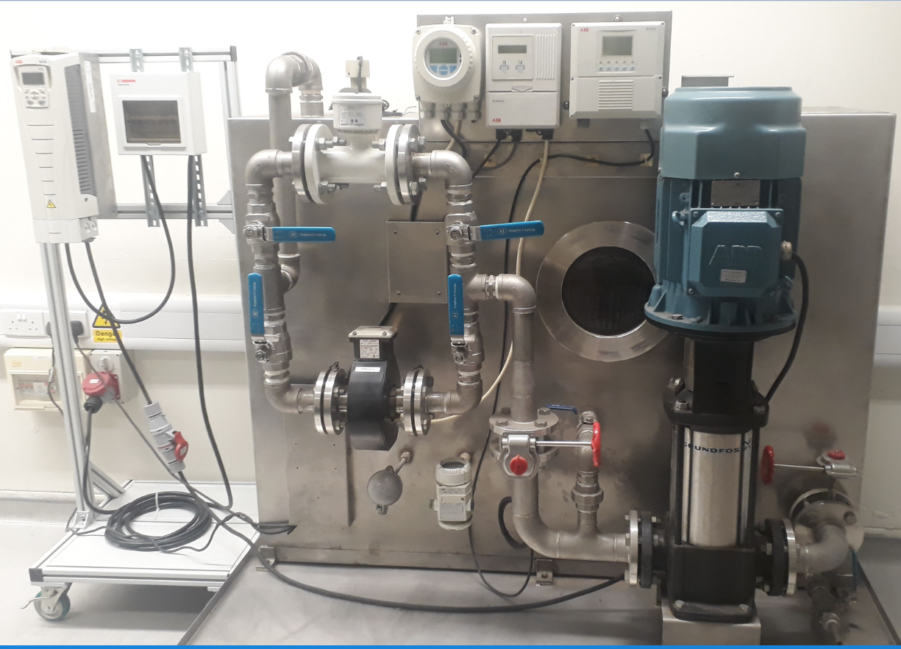
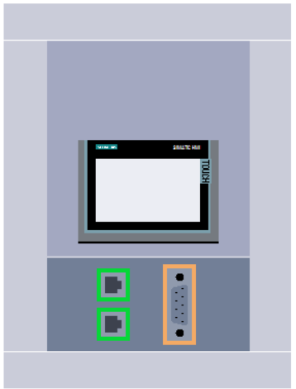
Case Study
Flowrate 4-20mA to AI
0-10V
AQ to VSD
Flowmeter
Transmitter
VSD
Motor
Flowmeter
Sensor
This is a manual system.
How could we automate this system to achieve flow control?
Pump
Resistance
Temperature to AI
Control
Valve
Pressure of water in tank
(Measure Level mmH2O)
to AI
Temperature
Sensor (RTD)
Pressure
Transmitter

Slide 15

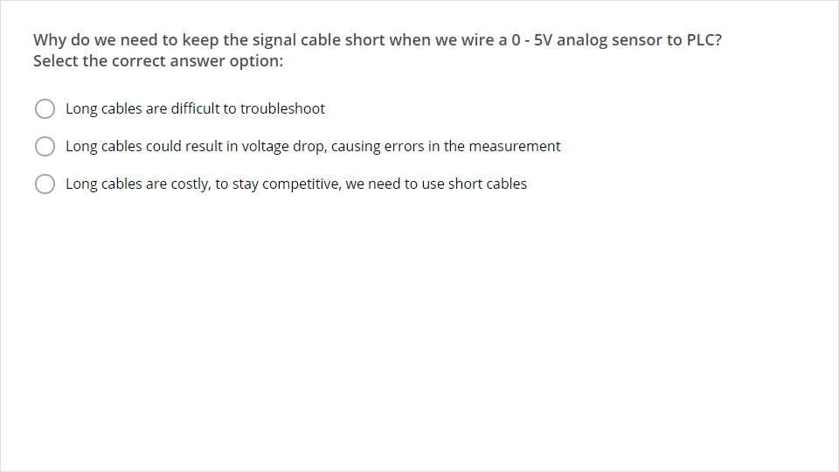
Quiz
Click the Quiz button to edit this object

